Slide 1
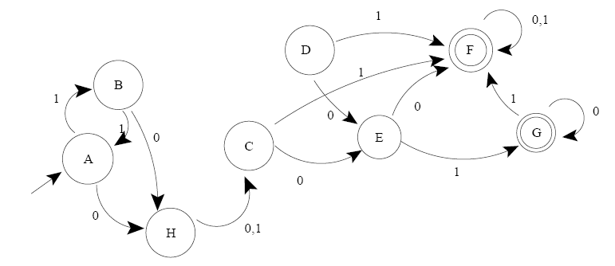
DFA
Often representing as a diagram:

Slide 2
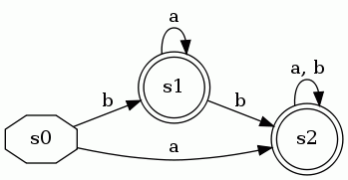
DFA Minimization
Some states can be redundant:
  The following DFA accepts (a|b)+
  State s1 is not necessary

Slide 3
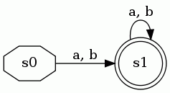
DFA Minimization
So these two DFAs are equivalent:

Slide 4
DFA Minimization
This is a state-minimized (or just minimized) DFA
  Every remaining state is necessary

Slide 5
DFA Minimization
The task of DFA minimization, then, is to automatically transform a given DFA into a state-minimized DFA
  Several algorithms and variants are known
  Note that this also in effect can minimize an NFA (since we know algorithm to convert NFA to DFA)

Slide 6


DFA Minimization Algorithm
Recall that a DFA M=(Q, Σ, δ, q₀, F)
Two states p and q are distinct if
  p F and q F or vice versa, or
  for some α Σ, δ(p, α) and δ(q, α) are distinct
Using this inductive definition, we can calculate which states are distinct

Slide 7
DFA Minimization Algorithm
Create lower-triangular table DISTINCT, initially blank
For every pair of states (p,q):
  If p is final and q is not, or vice versa
    DISTINCT(p,q) = ε
Loop until no change for an iteration:
  For every pair of states (p,q) and each symbol α
    If DISTINCT(p,q) is blank and
    DISTINCT( δ(p,α), δ(q,α) ) is not blank
      DISTINCT(p,q) = α
Combine all states that are not distinct

Slide 8
Very Simple Example
s0
s1
s2
 | s0 | s1 | s2

Slide 9
Very Simple Example
s0
s1 | ε
s2 | ε
 | s0 | s1 | s2
Label pairs with ε where one is a final state and the other is not

Slide 10
Very Simple Example
s0
s1 | ε
s2 | ε
 | s0 | s1 | s2
Main loop (no changes occur)

Slide 11
Very Simple Example
s0
s1 | ε
s2 | ε
 | s0 | s1 | s2
DISTINCT(s1, s2) is empty, so s1 and s2 are equivalent states

Slide 12
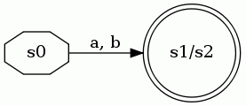
Very Simple Example
Merge s1 and s2

Slide 13
More Complex Example

Slide 14
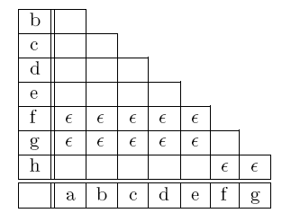
More Complex Example
Check for pairs with one state final and one not:

Slide 15
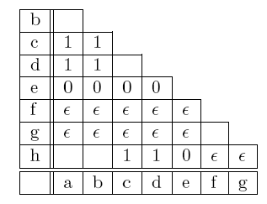
More Complex Example
First iteration of main loop:

Slide 16
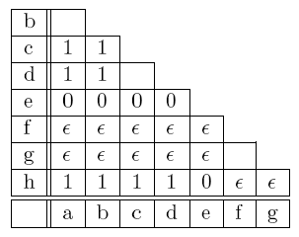
More Complex Example
Second iteration of main loop:

Slide 17
More Complex Example
Third iteration makes no changes
  Blank cells are equivalent pairs of states

Slide 18
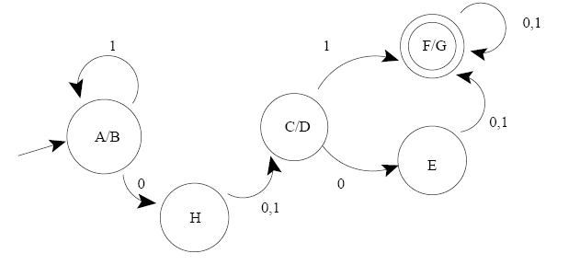
More Complex Example
Combine equivalent states for minimized DFA:

Slide 19
Conclusion
DFA Minimization is a fairly understandable process, and is useful in several areas
  Regular expression matching implementation
  Very similar algorithm is used for compiler optimization to eliminate duplicate computations
The algorithm described is O(kn²)
  John Hopcraft describes another more complex algorithm that is O(k (n log n) )
  n = no. of states, k = size of input alphabet

